Slide 1
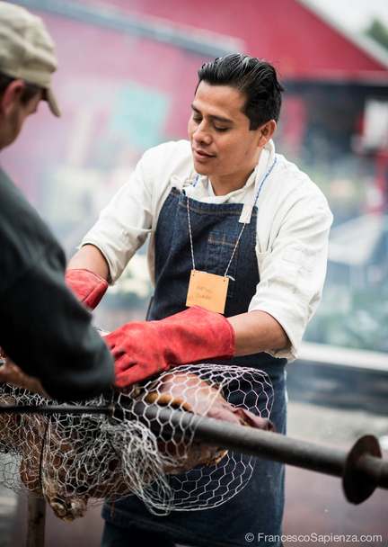
Neftalí Durán was born in Oaxaca, Mexico, and his interest in the region’s infinite gastronomy grew when he moved to Los Angeles in 1997. Chef Duran is currently focused on educating others about indigenous culinary traditions and cultivating synchronistic food styles that draw on Oaxacan roots. Duran owns and runs an artisan bread bakery where he handcrafts sourdough breads and bakes in a traditional wood-fired oven.
Chef Duran has been featured on Food52.com and The Cooking Channel, and as a signature pitmaster at the Cook 'n Scribble Longhouse Food Revival series in upstate New York. Duran was the sole Mexican chef invited to participate in the Native American Culinary Association’s Indigenous Food Symposium in December 2013, and he was invited to compete in the Smithsonian National Museum of the American Indian’s Native Chef 2014 Cooking Competition, where he was awarded the Smithsonian Native Chef of the year.

